Slide 1
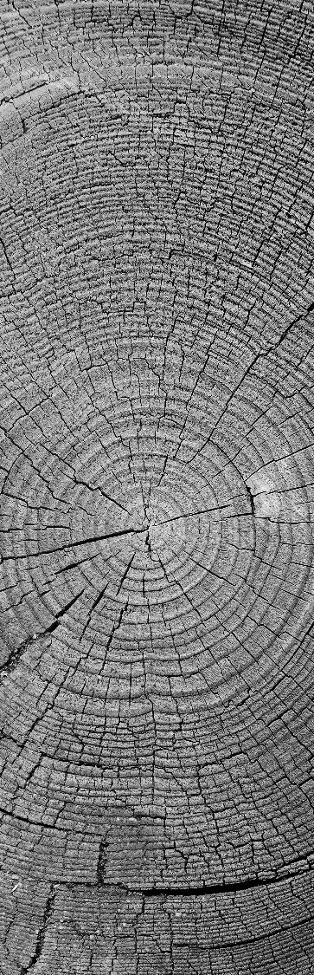
DATA StrUctures PACkage
19PW09

Slide 2

Railway Management System

Slide 3

Features of the system
The routes of different trains can be stored like a Railway Database.For example,
Train 1 will reach Station 1 at 9:00.
An existing train route can be edited as well.
The route of a desired train can be viewed.
The details of a desired station can be acquired.For example,the list of trains that arrive at the station with their respective timings.
Transit Stations Finder,that is to find the trains available between two stations.
Train Tracker,that is to find the current location of trains.

Slide 4
Data structure used
LINKED LIST

Slide 5
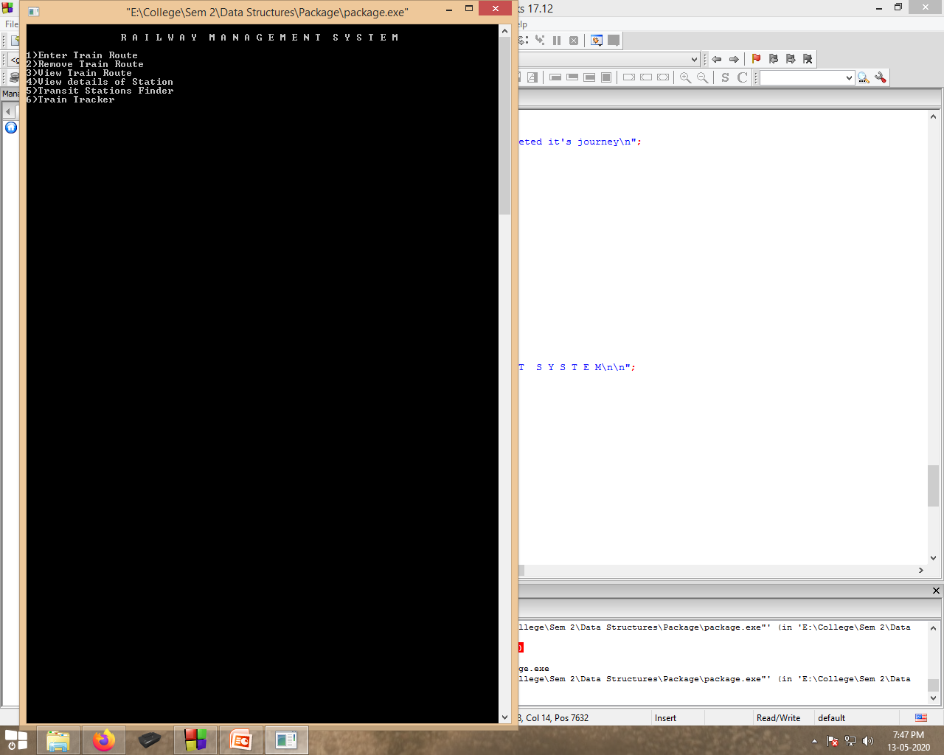
Main Screen

Slide 6

1)Enter train route

Slide 7
2)Remove Train Route

Slide 8
3)View train route

Slide 9
4)View details of station

Slide 10
5)Transit stations finder

Slide 11
6)Train tracker

Slide 12

Image SLide
THANK YOU

